Slide 1



Anna, TX
The National Community Survey™
2025 Results
Notes:
I am happy to be here to present a summary of the findings from the Anna National Community Survey
Before I begin, on behalf of myself and my Polco coworkers, I’d like to thank Charli Waggoner, our primary contact throughout the survey development and implementation process. They provided thoughtful and detailed feedback throughout the project.
I would also like to acknowledge my colleague, Lily Vasquez, who was Anna’s NCS project manager for this year’s survey and did the bulk of the work for this important project.

Slide 2



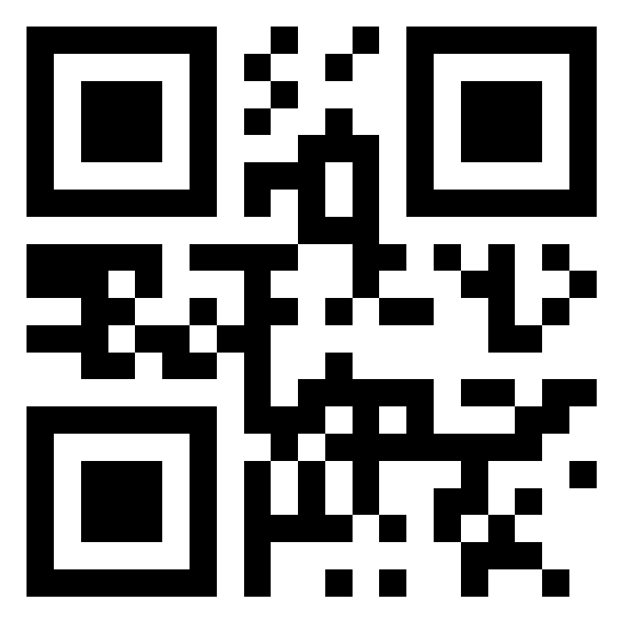



Civic Communication & Analytics Platform
Smarter, better-connected communities. A civic surveying, policy polling, and constituent communication tech platform.
Advanced Survey Science & Performance Analytics
Data insights to help communities move forward.
The premiere provider of professional civic surveys and performance benchmarking analyses.
Visit us online at
polco.us
Partners with:
Notes:
Before we dive into your results, I’d like to share a little bit About Polco:
Polco is an online community engagement platform providing local governments with resident and employee feedback. Now, hundreds of organizations nationwide use Polco for strategic planning, budgeting, and empowering resident voices.
Polco merged with National Research Center in 2019.
About NRC:
NRC is best known for our national benchmarking surveys, such as The National Community Survey (The NCS), the National Employee Survey, and the Community Assessment Survey for Older Adults, among others. Since 1994, we've worked with hundreds of jurisdictions nationwide.
Our benchmark database is the largest of its kind in the United States.
Polco also partners closely with:
International City/County Managers Association (ICMA)
The National League of Cities (NLC)
As well as many other local government leaders, like:
Alliance for Innovation (AFI)
Engaged Local Government Leaders (ELGL)
And many academic partners, including the American Association for Public Opinion Research, the University of Wisconsin-Madison, the Hoover Institute at Stanford University, and the Harvard Kennedy School of Government.

Slide 3




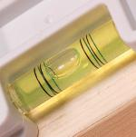
Resident Surveys in Local Governance
Monitor trends
in resident opinion
Measure government performance
Inform budget, land use, strategic planning decisions
Benchmark against other communities
Notes:
Before we dive into the results, I want to emphasize that there are a variety of ways these results can be used.
Most commonly, the jurisdictions we work with use their survey data to monitor trends in resident opinion over time and to inform budgeting processes and strategic plans. Our results also allow you to benchmark your community’s specific characteristics and services against communities in our benchmark database.
Our hope is that as these findings are presented, it will spur ideas for where you might want to dig deeper.

Slide 4

The NCS™ Facets of Community Livability
Economy
Mobility
Community Design
Utilities
Safety
Natural Environment
Parks & Recreation
Health and Wellness
Education, Arts, & Culture
Inclusivity & Engagement
Notes:
The National Community Survey, or The NCS, is a standardized five-page comprehensive survey that allows municipalities to assess resident opinion about their community and local government.
The NCS focuses on the “livability” of Anna by categorizing survey questions into 10 main “facets” of community livability as shown here.
These facets have been identified through extensive survey research as those that are most impactful to residents’ quality of life.
The NCS includes items within each of these ten facets, to provide a full picture of how residents feel about their community.
Finally, these facets also tend to align with municipal departments, making it easy for City staff to quickly find the information that is most important to them in the final report of results.

Slide 5

The National Community Survey™ in Anna
The NCS™ for Anna, TX
2nd time conducting The NCS (previous survey in 2022)
Survey conducted from June 23, 2025 – August 11, 2025
Mailing approach employed:
  Probability-based sample of 3,000 randomly selected households
  261 total responses received
  9% overall response rate
  Non-probability, open-participation survey: 588 responses
Results statistically weighted to reflect Anna overall
95% confidence interval with a +/- 6% margin of error
Notes:
All households within Anna were eligible to participate in the survey. A list of all households within the zip codes serving Anna was purchased based on updated listings from the United States Postal Service. Using GIS boundary files provided by the City, addresses located outside of Anna boundaries were removed from the list of potential households to survey. From that list, 3,000 addresses were randomly selected to receive the survey.
The 3,000 randomly selected households received mailings beginning on , and the survey remained open for 7 weeks. The first mailing was a postcard inviting the household to participate in the survey. The next mailing contained a cover letter with instructions, the five-page survey questionnaire, and a postage-paid return envelope. Both the postcard and cover letter included a web link to give residents the opportunity to respond to the survey online.
A total of 261 completed surveys were received from these efforts, providing a response rate of 9% and a margin of error of plus or minus 6 percentage points. We then compared the demographic profile of survey respondents to that of adults in Anna using the most recent Census and American Community Survey data and “weighted” the survey results. Weighting is a survey research best practice and helps to improve the representativeness of your survey results.
In addition to the randomly selected “probability sample” of households, a link to an online, community-wide “open participation” survey was publicized by Anna. The open participation survey was open to all City residents and became available on July 21, 2025. The survey remained open for 3 weeks and 588 responses were received.
This presentation and the report are based on the 261 responses from the random sample, mail-based survey; the responses to the open-participation survey are provided separately in the full report.

Slide 6
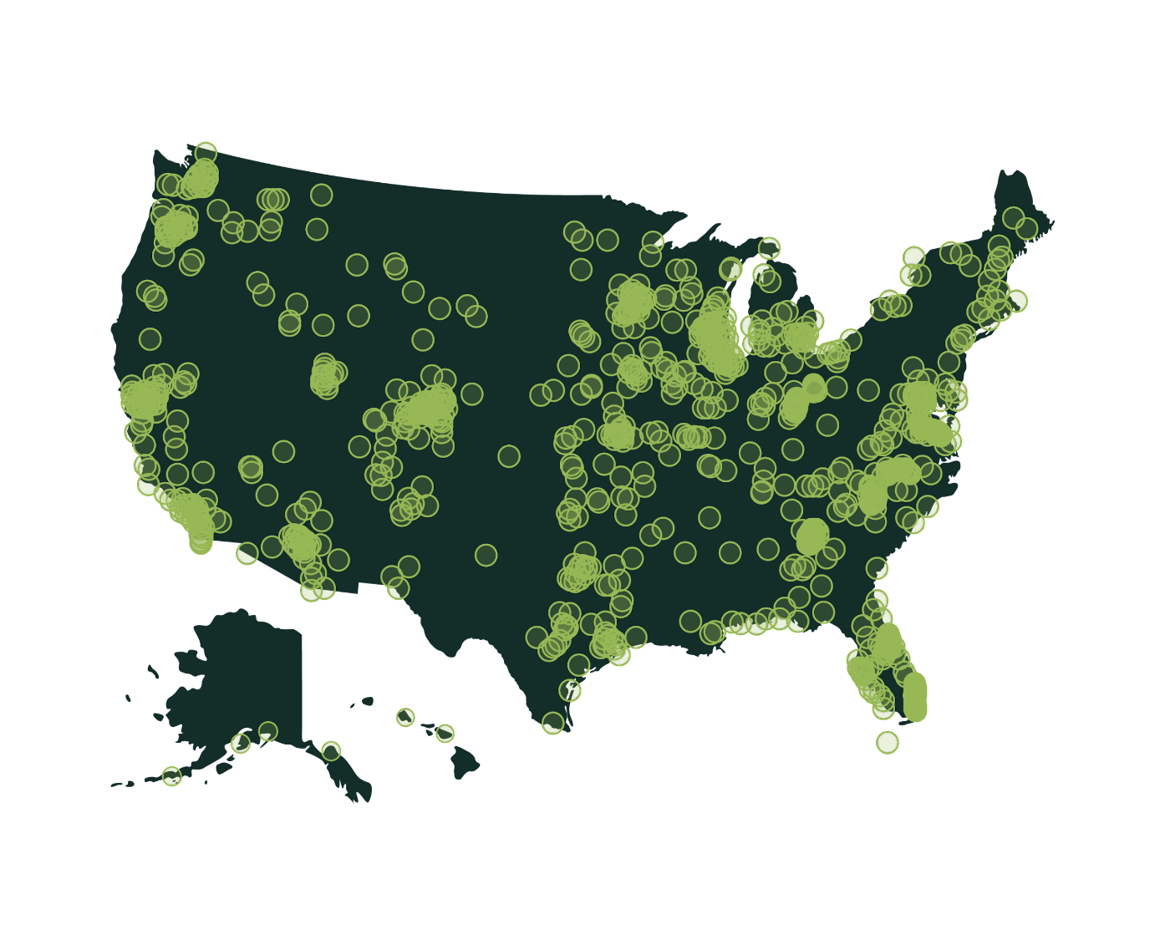
Polco’s Benchmarking Database
More than 500 comparison communities across the nation.
Representing the opinions of more than 50 million residents.
Notes:
One of the advantages to a local government of participating in our community surveys is the opportunity to compare ratings given by your residents to those from communities across the nation.
NRC was the first organization to conceive of the idea to create benchmarks of public opinion.
This allows jurisdictions to compare ratings of services to ratings of similar services from other communities.
There are currently about 500 communities in our database.

Slide 7


Overview of Survey Results

Slide 8
Facets of Community Livability: Quality
Percent excellent or good
Notes:
In the survey, we have two questions that ask directly about those 10 facets of community livability.
This first asks residents to rate the quality of each, and you can see the resulting comparison to the national benchmark in the shading on the chart.

Slide 9
Facets of Community Livability: Importance
Percent essential or very important
Notes:
The second question asks about the same facets of livability, but is centered on how important residents think it is for the community to focus on each facet in the coming two years.
So we ask about both the quality and importance of each of these facets, and we use those answers to create the quality/importance gap chart, which we’ll see on the next slide.

Slide 10
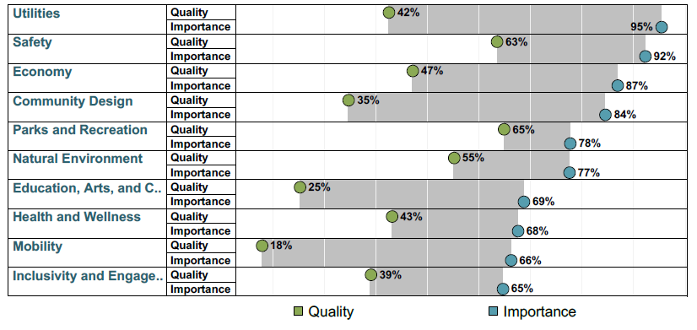
Balancing Quality and Importance
Notes:
We use this chart, which is also included in the report, to help determine which areas are of relatively higher importance and lower quality to residents.
This chart is one of many ways to interpret your data and can be used to identify key findings and help a community determine which areas may need additional focus or resource allocation in the coming years, and which others are performing well by comparison.

Slide 11
Comparisons to National Benchmarks
2 received higher ratings
70 received similar ratings
49 received lower ratings
Notes:
Of the 121 survey items for which residents provided evaluative ratings, 2 received ratings higher than the national benchmark, 70 received similar ratings, and 49 received lower ratings.
Ratings are considered similar if they are within 10 points of the national average, and higher or lower if they are more than 10 points different from the average.
Higher:
• Availability of affordable quality housing (46% excellent or good)
• Expected impact economy will have on their income (34% excellent or good)
Much Lower (lowest pctpost):
• Anna as a place to work (24% excellent or good)
• Anna as a place to visit (27%)
• Overall quality of the transportation system (18%)
• Overall opportunities for education, culture, and the arts (25%)

Slide 12
Comparisons to Previous Survey (2022)
4 received higher ratings
58 received similar ratings
58 received lower ratings
Notes:
When compared to results from Anna’s NCS results from 2022, in 2025, 5 received ratings that were statistically significantly higher than the previous survey iteration, 58 received similar ratings, and 58 received lower ratings.
Higher:
Water resources (beaches, lakes, ponds, riverways, etc.) (+9%)
Recreational opportunities (+10%)
Public library services (+17%)
Expected impact economy will have on their income (18%)
Lower (top 4 with greatest change):
Overall economic health of Anna (-28%)
The overall quality of life in Anna (-24%)
Ease of travel by car in Anna (-23%)
Anna as a place to live (-22%)

Slide 13
Key Findings
Notes:
Moving now into the highlights of our findings, I do want to point a few items that stood out to us as survey researchers.
There is a lot of additional data in the full report that we won’t cover today, but today’s presentation will focus on a few areas that we found to be most noteworthy within Anna’s survey results.

Slide 14

Safety remains Anna’s strongest asset, consistent with national averages despite some declines.
1

Slide 15
Safety in Anna
Top rated safety services:
• Fire services (88% excellent or good)
• Ambulance or emergency medical services (82%)
About
9 in 10
residents felt safe:
In their neighborhood during the day
In downtown/commercial areas during the day
Notes:
• About 9 in 10 residents feel safe in their neighborhoods and in downtown/commercial areas during the day, but on par with the national average.
• Fire services highest-rated city service with 9 in 10 respondents giving high marks.
• Ambulance/EMS and Police services were also rated positively from roughly 8 in 10 community members, though showing a decline from the previous survey, but still consistent with other comparison communities.

Slide 16

Environmental services are steady, with progress in water resources but overall ratings below benchmarks.
2

Slide 17


Natural Environment in Anna
Please rate each of the following in the Anna community:
National
Benchmark
Comparisons:
2025 vs 2022:
Increasing/Decreasing
Percent excellent or good
Notes:
• About 3 in 4 residents rated recycling positively, making it one of the strongest environmental services and consistent with national averages.
• Water resources improved from about 1 in 4 residents in 2022 to 1 in 3 in 2025, showing a notable upward trend, though still below the national benchmarks.
• Around 5 in 10 residents gave positive marks for preservation of natural areas and open space, both aligned with other communities.
• Overall, about half of residents rated the natural environment positively, a decline compared to the prior survey and lower than the benchmark.
• Yard waste pick-up (59% excellent or good) remained consistent with trends and the national average.

Slide 18

Engagement and inclusivity remain on par with national norms, though trending downward.
3

Slide 19
Community Enrichment in Anna
Please rate each of the following in the Anna community:
National
Benchmark
Comparisons:
2025 vs 2022:
Increasing/Decreasing
Percent excellent or good
Notes:
• About 5 in 10 residents rated opportunities to volunteer and opportunities to participate in community matters positively, stable compared to previous years and on par with national averages.
• Roughly 6 in 10 said Anna makes residents feel welcome and positively rated the City attracting people from diverse backgrounds, though these marks declined since 2022.
• Valuing/respecting residents from diverse backgrounds (63% excellent or good) was the highest rated item in this facet.
• Taken together, these ratings show that inclusivity and engagement are generally consistent with national norms, but with some softening over time.

Slide 20

Quality of life has fallen below benchmarks, with significant declines since 2022.
4

Slide 21
Quality of Life in Anna
Please rate each of the following in the Anna community:
National
Benchmark
Comparisons:
2025 vs 2022:
Increasing/Decreasing
Percent excellent or good
Notes:
• About 6 in 10 residents rated overall quality of life positively, a sharp decline from nearly 8 in 10 in 2022 and lower than the benchmark.
• Roughly 6 in 10 residents plan to remain in Anna for the next five years and would recommend living in the community, though both ratings slipped since 2022.
• Fewer than 5 in 10 rated the City’s overall image or reputation positively, the lowest score in this area.

Slide 22

Economic health and development have declined, falling below national benchmarks.
5

Slide 23
Economy in Anna
Please rate each of the following in the Anna community:
National
Benchmark
Comparisons:
2025 vs 2022:
Increasing/Decreasing
Percent excellent or good
Notes:
• About 5 in 10 residents rated Anna’s overall economic health positively, a sharp decline from nearly 8 in 10 in 2022, but still on par with the national average.
• Roughly 5 in 10 residents rated economic development positively, down from 6 in 10 in 2022.
• Shopping and employment opportunities remain low, with fewer than 2 in 10 residents giving positive ratings, both falling below other comparison communities.
• Perceptions of the overall quality (49% excellent or good) and variety (35%) of business and services establishments and the vibrancy of the downtown/commercial area (24%) remained relatively stable from the previous survey though all fell below the national average.

Slide 24

Public library services is on the rise, rated the highest upward trend in services.
6

Slide 25
Services in Anna
2025 vs 2022:
Increasing/Decreasing
Please rate each of the following in the Anna community:
National
Benchmark
Comparisons:
Public Library Services
17% 34%
In 2022 In 2025
+17%
Percent excellent or good

Slide 26

Traffic and travel ratings show steep declines, making transportation a top priority.
7

Slide 27
Mobility in Anna
Please rate each of the following in the Anna community:
2025 vs 2022:
Increasing/Decreasing
National
Benchmark
Comparisons:
Percent excellent or good
Notes:
• Only about 2 in 10 residents rated traffic flow on major streets positively, a significant decline since 2022 and well below the national benchmark.
• Ease of travel by car dropped from about 7 in 10 residents in 2022 to fewer than 5 in 10 in 2025, a notable downward trend.
•Though ease of travel by bicycle and by public transportation remained stable from the previous survey, both fell much lower than other comparison communities.
•Similarly, ease of walking (33% excellent or good) also saw a downward trend and fell below the national average.

Slide 28




Mobility Services in Anna
54%
54%
53%
36%
Street cleaning
Traffic enforcement
Sidewalk maintenance
Street repair
2025 vs 2022:
Increasing/Decreasing
Percent excellent or good
Notes:
• About half of community members gave positive ratings to street cleaning and sidewalk maintenance, both experiencing a downward trend from the previous survey.
•Traffic enforcement received positive marks from about 5 in 10 participants, on par with the national average.
• Street repair was the lowest rated item in this area, also seeing a statistically significant decline.

Slide 29
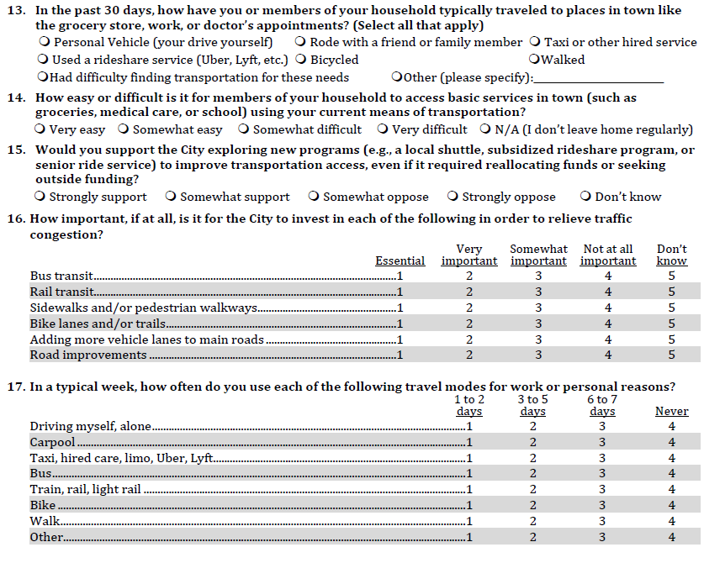
Additional Special Topics
3

Slide 30
Custom Question #1
In the past 30 days, how have you or members of your household typically traveled to places in town like the grocery store, work, or doctor’s appointments? (Select all that apply)
30
Notes:
• Nearly all residents indicated they use a personal vehicle (99%), followed by riding with a friend or family member (27%) to travel to places in town.
• About 2 in 10 participants also indicated they walked.
•3% of residents indicated they had difficulty findings transportation for these needs.

Slide 31
Custom Question #2
How easy or difficult is it for members of your household to access basic services in town (such as groceries, medical care, or school) using your current means of transportation?
31
Notes:
• About 6 in 10 residents indicated it’s very easy for members of their household to access basic services in town using their current means of transportation.
• About 3 in 10 community member indicated it’s somewhat easy.
• About 1 in 10 participants indicated it was somewhat difficult with only 1% indicating it was very difficult.

Slide 32
Custom Question #3
Would you support the City exploring new programs (e.g., a local shuttle, subsidized rideshare program, or
senior ride service) to improve transportation access, even if it required reallocating funds or seeking
outside funding?
32
Notes:
• About 3 in 10 residents indicated they strongly support the City exploring new programs to improve transportation access, even if it required reallocating funds or seeking outside funding.
• About 4 in 10 community members indicated they were somewhat in support.
• Fewer than 1 in 10 participants somewhat opposed, while about 2 in 10 strongly opposed.
•Less than 1 in 10 respondents felt unsure.

Slide 33
Custom Question #4
How important, if at all, is it for the City to invest in each of the following in order to relieve traffic congestion?

Slide 34
Custom Question #5
In a typical week, how often do you use each of the following travel modes for work or personal reasons?

Slide 35

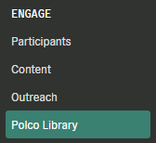
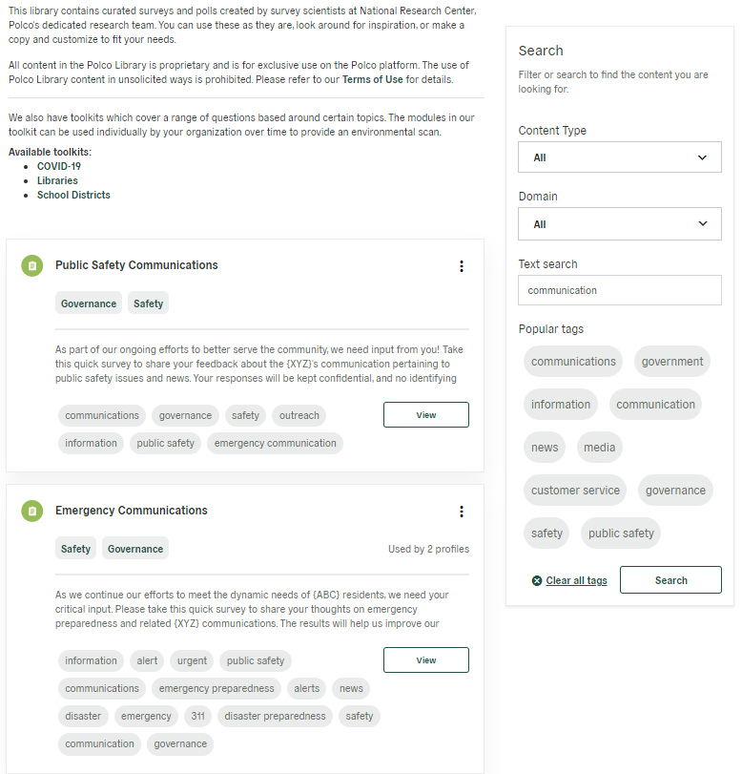


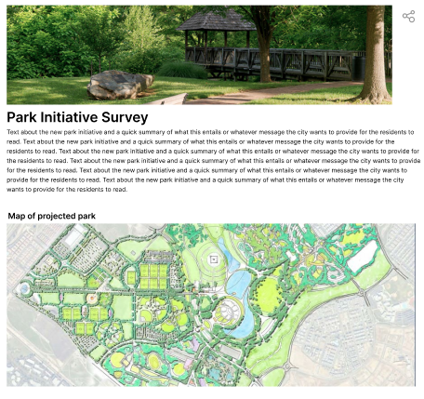


Next Steps: ENGAGE With Community Members
Customizable surveys and polls created by survey scientists at Polco.
Anna
currently has
1,152
subscribers on Polco.
Included in Current Subscription
Optional Add-on
Notes:
If you wish to dig deeper to find out more about the opinions and perceptions of residents, you can continue to engage with your community on Polco.
Anna currently has 1,152 residents who have subscribed to your Polco profile – you have an opportunity to create a consistent dialogue with these community members!
Polco’s Engage module is included as a part of your current subscription. Engage includes various resident feedback tools, including customizable polls, surveys, and live events.
Questions within these tools can include maps, images, videos or links to better inform respondents.
The Polco library is also included as part of the Engage module and contains curated surveys and polls created by survey scientists at Polco.
You can use these as they are, look around for inspiration, or make a copy of a survey and customize it to fit your needs.
Alternatively, if you have a survey or poll in mind, you can create one from scratch and reach out to your subscribers for feedback.
You do not have to do this all on your own: the Engage module provides you with access to a dedicated Customer Success Manager and Survey Researcher who are here to help you along the way!

Slide 36
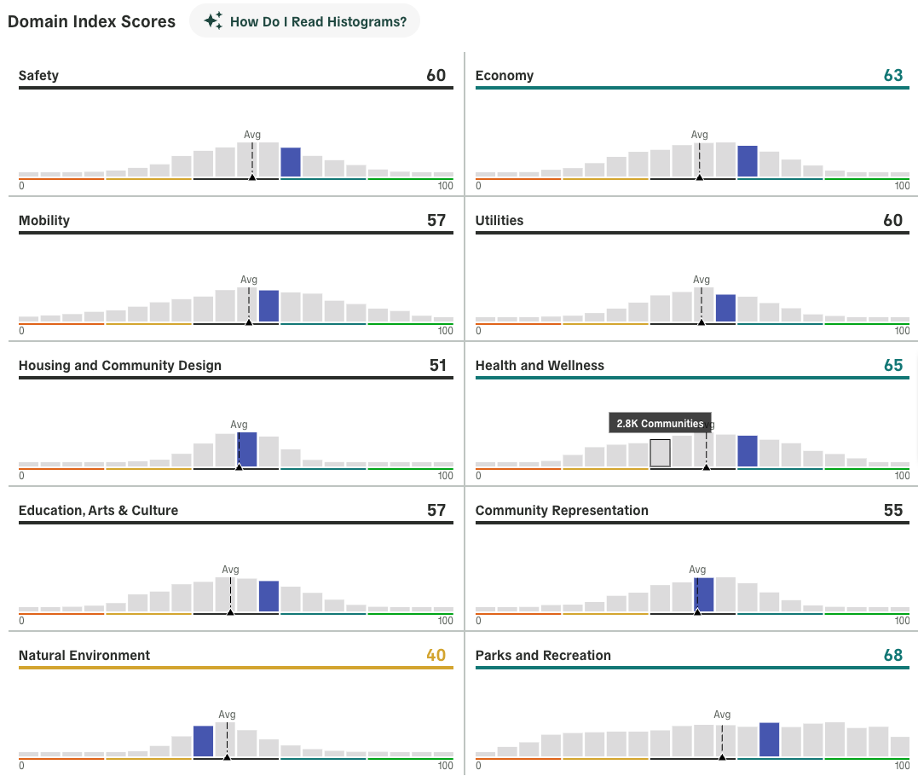
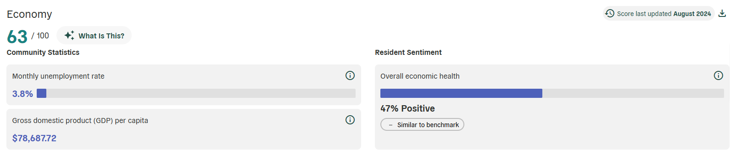
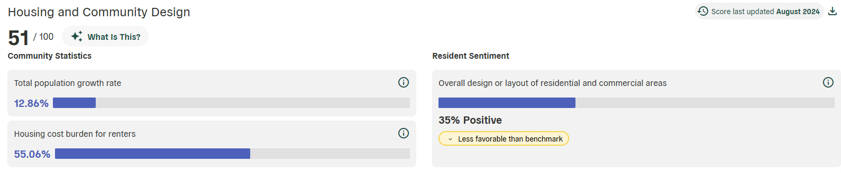
Next Steps: TRACK Anna’s Data
Included in Current Subscription
Optional Add-on
Notes:
*Data from Anna, TX
Polco’s Track module is also included in your current subscription.
The Track Overview Dashboard, shown on the left, provides a big-picture look at your community data.
It includes key metrics, measures of performance over time, and compares Anna to peer communities within your state and within specific populations parameters
The dashboard is backed by academic, public, and private data in partnership with ICMA, NLC, Stanford University, Arizona State University, and the University of Wisconsin-Madison
In addition to the Overview Dashboard, individual dashboards for each of the 10 facets of livability are available for purchase
These Domain Dashboards provide a deep dive into a single facet and include dozens of publicly available datapoints that are tracked over time, benchmarked against other communities, and automatically updated for you
We track broad indicators like unemployment and crime rates, as well as very specific items like the percentage of children eligible for free or reduced lunch or the percentage of resident who live within a half mile of a public park
These Track offerings help communities best utilize a performance management system without the hassle of manual tracking or guesswork.

Slide 37


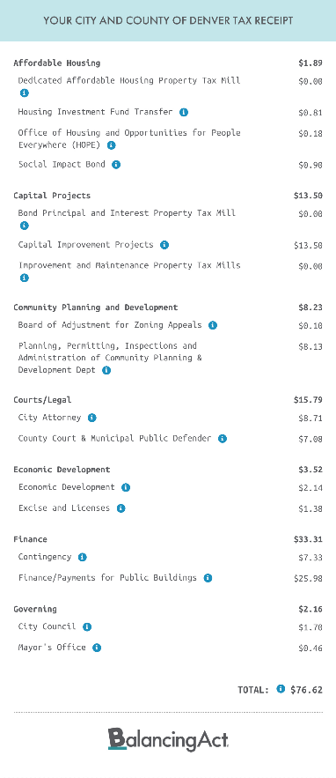
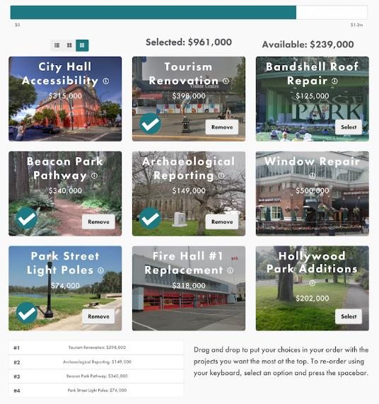


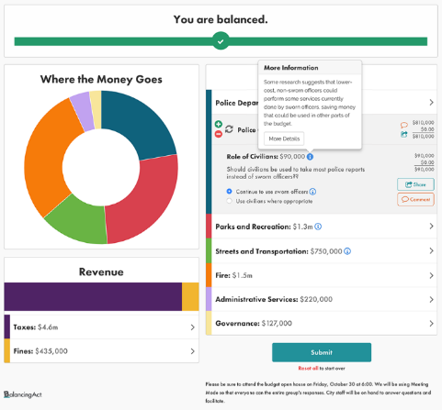



Additional Offerings: Continue to ASSESS
Included in Current Subscription
Optional Add-on
Notes:
Polco’s final module, Assess, includes benchmark surveys, like The NCS, which were developed by in-house data scientists and have been conducted in hundreds of jurisdictions nationwide over the past 25 years.
Each assessment targets a different subsection of your community, allowing you to focus efforts as needed.
Implementing different benchmark surveys can provide additional context for your data and give you a deeper understanding of your community's overall performance.
Benchmark assessments provide the most value when conducted regularly (at whatever cadence is right for you!) to refresh your results and see historical trends over time.
In 2023, Polco added Balancing Act and its suite of engagement tools to our Assess module, including Simulations, Taxpayer Receipt, and Prioritize.
Simulations allow residents to interact with a model of the City budget or housing plan and collects their input.
The taxpayer receipt lets users see an estimate of where the tax dollars went over the last fiscal year.
Prioritize is an engagement tool which allows residents to share their priorities on specific City projects
If interested, each of these Assess offerings can be added to your subscription.

Slide 38
Thank you!
Questions?
Tobin McKearin
COO
Polco/National Research Center
tobin@polco.us

